Slide 1
SAT
Recommendations on Increasing Participation Rates.
By Susan Mensah

Slide 2
Current Participation Rate
As it stands, based on the statistics gathered from 2017 testing, SAT has an average participation rate of about 39% while ACT has an average participation rate of about 65%.
The reason for this is partly because there are more some states that have mandated ACT for all test takers than SAT.
There are 17 states that have ACT mandated while there are 4 states that mandate there students to take the SAT

Slide 3
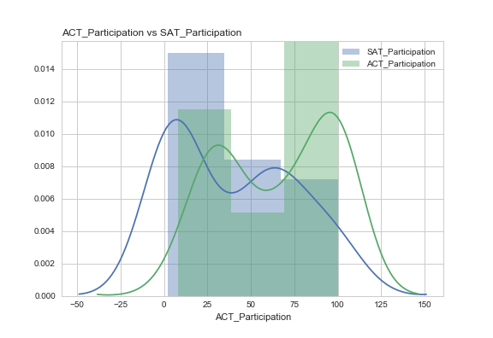
ACT vs SAT Participation
ACT participation acts reversely to SAT participation. Hence, states where there is a high participation in one test, the is a low participation in the other test

Slide 4
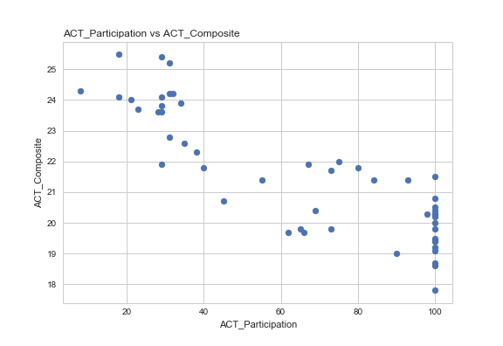
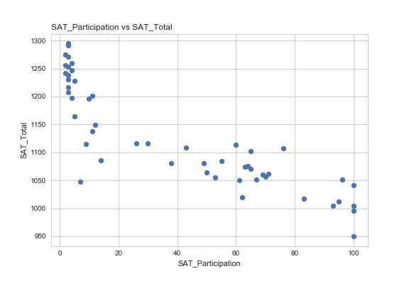
Success Rates vs Participation Rates.
The lower the participation rates, the higher the test scores in each state.

Slide 5
Should but tests be compared to one another?
No, there is a statistically significantly difference to show that there is a difference in the average participation rate with a 95% confidence level. As a result, we are unable to truly compare one to the other.

Slide 6
Findings:
Our findings show that:
Test scores seem to decrease in states that have a higher participation rate and increase in states lower participation for both tests.
ACT has a higher participation rate than SAT
The higher the participation rate in one test with a state, the lower the participation rate of the other in the same state

Slide 7
Inference:
Based on our observations, we can infer that ACT is the most common test nationwide, however, both tests are uncomparable because of the statistical difference in there mean.
Hence, we cannot say that one test weigh more than the other, neither can be conclude which test is better.
What we can infer is that the states with higher test scores have students who may have prepared better for that particular test they took and therefore score better.

Slide 8
Conclusion
My recommendation is that focus should be on preparing students better in taking the SAT test and this will result in better test scores. As we begin to see better test scores, the popularity will increase, hence, increase in participation rates. There is also the attraction of only having to prepare for only Maths and English as opposed to the additional science test that exist in ACT

